Slide 1
The First Amendment and The Supreme Court
Lesson Plan developed for the
Historic Polegreen Church Foundation
May, 2010

Slide 2
The First Amendment
Congress shall make no law respecting an establishment of religion, or prohibiting the free exercise thereof; or abridging the freedom of speech, or of the press; or the right of the people peaceably to assemble, and to petition the Government for a redress of grievances.
Ratified by the United States
December 15, 1791 on the vote of Virginia’s General Assembly
Citation: http://topics.law.cornell.edu/constitution/billofrights
Notes:
"December 15, 1791 on the vote of Virginia's general Assembly" Note: on 15 December the Bill of rights became law because on that day the Virginia Senate concurred with earlier votes of the Virginia House to ratify, making the Virginia General Assembly the eleventh (and thus decisive) state to act.

Slide 3
Virginia Statute for Religious Freedom
…Be it enacted by General Assembly that no man shall be compelled to frequent or support any religious worship, place, or ministry whatsoever, nor shall be enforced, restrained, molested, or burthened in his body or goods, nor shall otherwise suffer on account of his religious opinions or belief, but that all men shall be free to profess, and by argument to maintain, their opinions in matters of Religion, and that the same shall in no wise diminish, enlarge or affect their civil capacities…
Adopted in 1786 by the Virginia General Assembly
Drafted by Thomas Jefferson
Citation:http://www.lva.virginia.gov/lib-edu/education/bor/vsrftext.htm

Slide 4
Virginia Declaration of Rights
XVI - That religion, or the duty which we owe to our Creator and the manner of discharging it, can be directed by reason and conviction, not by force or violence; and therefore, all men are equally entitled to the free exercise of religion, according to the dictates of conscience; and that it is the mutual duty of all to practice Christian forbearance, love, and charity towards each other.
Adopted June 12, 1776 by Virginia Convention of Delegates
Drafted by George Mason
Citation: http://avalon.law.yale.edu/18th_century/virginia.asp
Notes:
Note: the green highlighted text was actually an important substitution suggested by Madison for Mason's original "toleration" language.

Slide 5
The First Amendment
Congress shall make no law respecting an establishment of religion, or prohibiting the free exercise thereof; or abridging the freedom of speech, or of the press; or the right of the people peaceably to assemble, and to petition the Government for a redress of grievances.
Ratified by the United States
December 15, 1791
Citation: http://topics.law.cornell.edu/constitution/billofrights

Slide 6
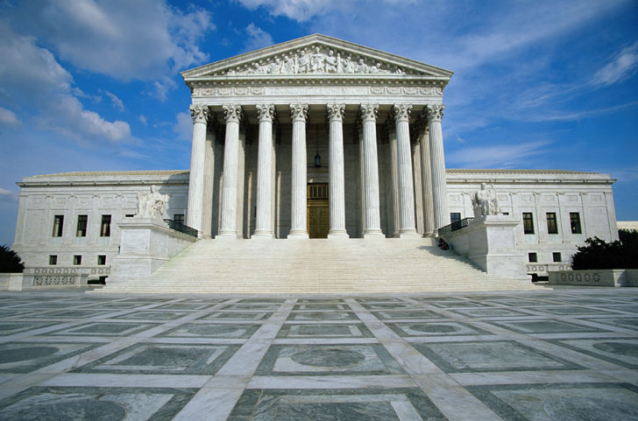
The Supreme Court
Three Important Cases:
Abington School District v Schempp, 1963
Lemon v Kurtzman, 1971
Wallace v Jaffree, 1985

Slide 7
Everson v Board of Education, 1947
Background:
A NJ law allowed for reimbursement for parents who sent their children to parochial schools on public transportation
Question:
Did the NJ statute violate the Establishment Clause of the First Amendment?
Ruling:
No, services like busing and police protection for parochial schools are separate and therefore constitutional; Justices used Jefferson’s “wall of separation” claim
Citation: http://www.oyez.org/cases/1940-1949/1946/1946_52/
Notes:
significant case on religion with public schools and the first to apply the First Amendment's clauses on religion to the states, via the 14th. SCOTUS ruled in favor of NJ's use of tax dollars to fund bussing costs to parochial schools. It used Jefferson's "wall of separation" metaphor, but decided, 5-4, that the NJ law did not breach that wall .

Slide 8
The First Amendment
Congress shall make no law respecting an establishment of religion, or prohibiting the free exercise thereof; or abridging the freedom of speech, or of the press; or the right of the people peaceably to assemble, and to petition the Government for a redress of grievances.
Ratified by the United States
December 15, 1791
Citation: http://topics.law.cornell.edu/constitution/billofrights

Slide 9
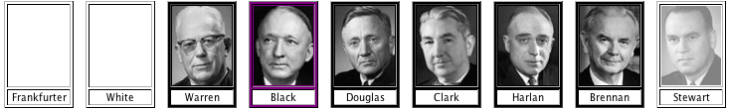
Engel v. Vitale, 1962
Background:
NY Board of Regents allowed a short prayer at start of school
Question:
Does the reading violate the First Amendment?
Ruling:
Yes, promotion of religion
Citation: http://www.oyez.org/cases/1960-1969/1961/1961_468
Notes:
Text of the Prayer is; "Almighty God, we acknowledge our dependence upon Thee, and beg Thy blessings upon us, our teachers, and our country."
Justice Felix Frankfurter suffered a cerebral stroke that forced him to retire, and Justice Byron White took no part in the case.^{[2]}
Still a controversial decision, some felt the fact it was voluntary made it ok, but supc said it wasn’t
It's significant on its own, but may also help illustrate the shift with the "Lemon Test" and help explain the furor that erupted after Engel v. Vitale (1963)--which is another landmark case involving prayer in schools and on which JFK made public comments. Engel also led to efforts toward a Constitutional amendment to allow prayer ...

Slide 10

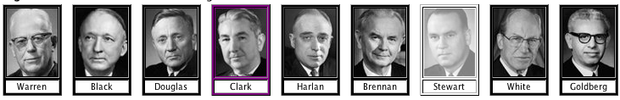
Abington School District v. Schempp, 1963
Background:
Bible reading in PA public schools
Lord’s Prayer following
Written note
Question:
Was this a violation of the 1st and 14th Amendments?
Ruling:
Yes.
Free exercise and establishment clause
"intended by the State to be so."
Citation: http://www.oyez.org/cases/1960-1969/1962/1962_142

Slide 11
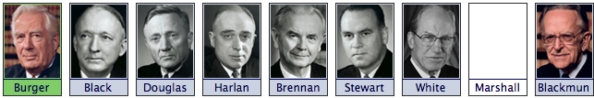
Lemon v Kurtzman, 1971
Background:
Controversy over law in PA and RI
State funding to non-public schools (Catholic)
Question:
Did the statutes violate the 1st Amendment’s Establishment Clause by giving state $ to "church-related educational institutions"?
SUPC Ruling:
Yes; established the Lemon Test
Citation: http://www.oyez.org/cases/1970-1979/1970/1970_89/

Slide 12
Lemon Test
a secular legislative purpose
not have the primary effect of either advancing or inhibiting religion
3. not result in an "excessive government entanglement" with religion

Slide 13
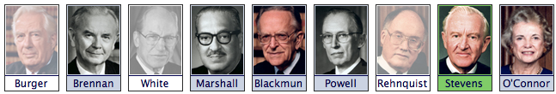
Wallace v. Jaffree, 1985
Background:
AL law, authorized teachers to conduct prayer during school day
Question:
Did the AL law violate the constitution?
Ruling:
Yes, it was an affirmative endorsement of religion
Citation: http://www.oyez.org/cases/1980-1989/1984/1984_83_812

